Slide 1
SAMPLE PACTS WITH THE DEVIL
Theophilis, 13th c
Dr. Johannes Faustus, 1587
Father Urbain Grandier, early 17th c
The Red Dragon, Sorcerers’ Handbook, 17th c

Slide 2

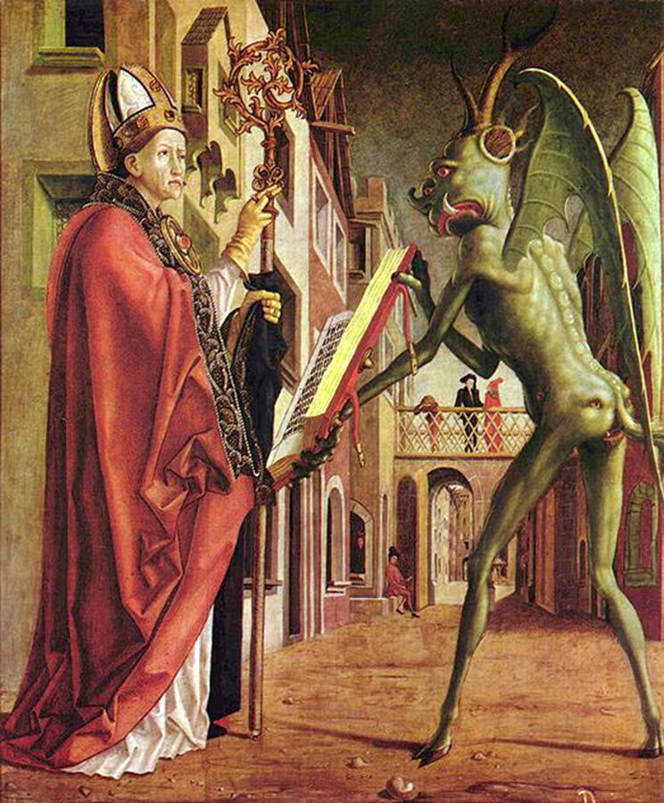
Theophilus’ pact, 13th c
Theophilus’ pact as reported by Satan in “The Miracle of Theophilus” (13th century) by the French troubadour Ruteboeuf
“To all who shall read this open letter I, Satan, let know that the fortune of Theophilus is changed indeed, and that he has done me homage, so might he have once more his lordship, and that with the ring of his finger he has sealed this letter and with his blood written it, and no other ink has used therein.”

Slide 3
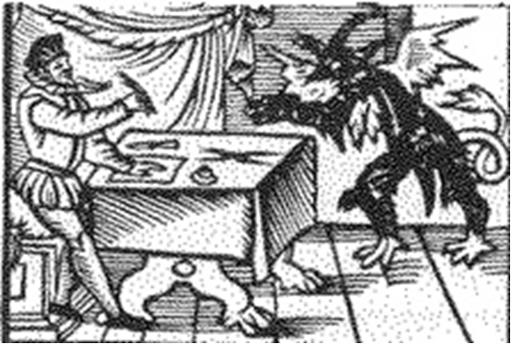
Dr. Faust’s Pact with the Devil (from the Faustbook 1587)
I Johannes Faustus, Doctor, do openly acknowledge with mine own hand, to the greater force and strengthening of this letter, that since I began to study and speculate the course and order of the elements, I have not found through the gift that is given me from above, any such learning and wisdom, that can bring me to my desires: and for that I find, that men are unable to instruct me any farther in the matter, now have I, Doctor John Faustus, unto the hellish prince of Orient and his messenger Mephostophiles, given both body and soul, upon such condition, that they shall learn me, and fulfill my desire in all things, as they have promised and vowed unto me, with due obedience unto me, according unto the articles mentioned between us.
Further, I covenant and grant with them by these presents, that at the end of 24 years next ensuing the date of this present letter, they being expired, and I in the meantime, during the said years be served of them at my will, they accomplishing my desires to the full in all points as we are agreed, that then I give them full power to do with me at their pleasure, to rule, to send, fetch, or carry me or mine, be it either body, soul, flesh, blood, or goods, into their habitation, be it wheresoever: and hereupon, I defy God and his Christ, all the host of heaven, and all living creatures that bear the shape of God, yea all that lives; and again I say it, and it shall be so. And to the more strengthening of this writing, I have written it with mine own hand and blood, being in perfect memory, and hereupon I subscribe to it with my name and title, calling all the infernal, middle, and supreme powers to witness of this my letter and subscription.
John Faustus, approved in the elements and the spiritual doctor

Slide 4
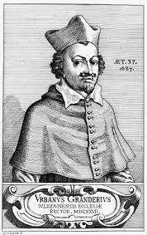
Grandier’s Vow (early 17th century)
“My Lord and Master, I own you for my God; I promise to serve you while I live, and from this hour I renounce all other gods and Jesus Christ and Mary and all the Saints of Heaven and the Catholic, Apostolic, and Roman Church, and all the goodwill thereof and the prayers which might be made for me. I promise to adore you and do you homage at least three times a day and to do the most evil that I can and to lead into evil as many persons as shall be possible to me, and heartily I renounce the Chrism, Baptism, and all the merits of Jesus Christ; and in case I should desire to change, I give you my body and soul, and my life as holding it from you, having dedicated it for ever without any will to repent.
Signed Urbain Grandier in his blood.”

Slide 5
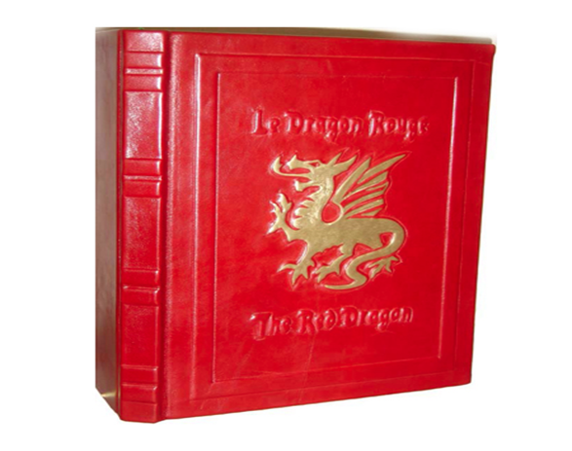
The template for a pact with the Devil in “The Red Dragon,” the sorcerers’ handbook, “The Keys of Solomon” (17th century)
“Emperor Lucifer, master of all the rebellious spirits, I beseech thee be favorable to me in the calling which I make upon thy great minister LUCIFUGE ROFOCALE, having desire to make a pact with him; I pray thee also, Prince Beezlebub, to protect me in my undertaking. O Count Ashtoreth! be propitious to me, and cause that this night the great LUCIFUGE appear unto me in human form and without any evil smell, and that he grant me, by means of the pact which I shall deliver to him, all the riches of which I have need. O great Lucifugé, I beseech thee leave thy dwelling, in whatever part of the world it may be, to come and speak with me; if not, I will thereto compel thee by the power of the mighty words of the great Keys of Solomon, whereof he made use to force the rebellious spirits to accept his pact. Appear, then, instantly, or I will continually torment thee by the mighty words of the Keys!”
Spirit’s reply: “I cannot grant thy demand but on condition thou give me thyself at the end of twenty years, so that I do with thee, body and soul, what shall please me.”
Advice on what to do: “Then you shall throw him your pact, which must be written in your own hand on a little piece of virgin parchment; it shall consist of the few words given below and shall be signed with your veritable blood:
PACT
I promise great LUCIFUGE to repay him in twenty years for all he shall give me, In witness whereof I have signed. X”

Slide 6
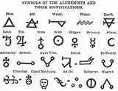
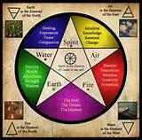
MAGIC WORDS
ALCHEMY
ASTROLOGY
NECROMANCY
SOOTHSAYING
SORCERY

Slide 7
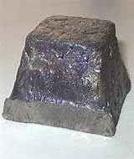

ALCHEMY Pb Au
A medieval chemical philosophy having as its aim the transmutation of base metals into gold, the discovery of the panacea, and the preparation of the elixir of longevity.

Slide 8
ASTROLOGY
The study of the positions and aspects of heavenly bodies in the belief that they have an influence on the course of human affairs.

Slide 9
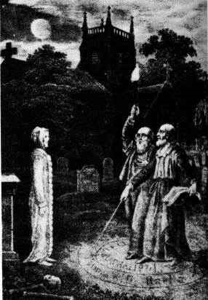
NECROMANCY
The practice of communicating with the spirits of the dead in order to predict the future. Black magic, sorcery.
From Greek: necromanteia, nekras (corpse) + manteia (divination)

Slide 10
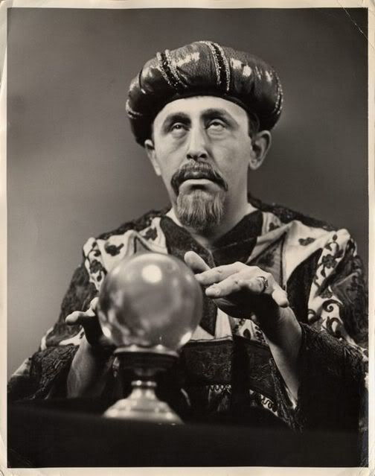
SOOTHSAYING
The art or practice of foretelling events.

Slide 11
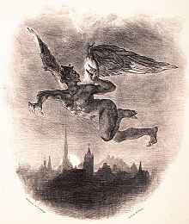
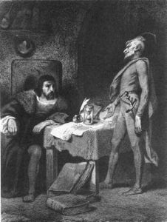
SORCERY
SORCERY
The use of supernatural power over others through the assistance of evil spirits.
Upper left:Mephistopheles flying over Wittenburg by Eugene Delacroix
Lower right: Faust’s Study

